Slide 1
What makes a good Data Dashboard?
September 2020
Saudi Digital Academy
Notes:
Scannable
most important data first
What’s the question? Here’s the answer.
Dashboard makes things understandable
Organize a lot of data
Must be clear

Slide 2
What does your audience need?
Think about the needs of your users.
Notes:
Most dashboard design principles revolve around the needs of the end users. Before starting the design process, determine what information the user wants to analyze.
Work with the users, clients, or stakeholders to select relevant key performance indicators (KPIs). The data that you need to display in the dashboard helps shape the rest of the design process. Once you set the KPIs, you can begin selecting the right type of dashboard and visualization tools.
Keep in mind that the KPIs may come from a wide range of data sources. As part of the design process, you may need to connect to these sources using various APIs. The variety of data sources could impact the timeframe for the project.

Slide 3
What type of Dashboard?
Select the right type.
Notes:
As part of the dashboard design principles used by experienced designers, selecting the right type of dashboard is an essential step. If the dashboard is intended for high-level executives and decision-makers, you may need a KPI dashboard. Supervisors monitoring employee actions may need an operational dashboard.
What is a KPI dashboard? A KPI dashboard includes insight from KPIs. These dashboards are typically strategic dashboards used for senior managers and stakeholders. The dashboard helps identify opportunities for growth and improving business strategies.
A KPI dashboard offers an overview of existing business metrics. It allows executives to understand the effectiveness of various strategies and the health of the company. These dashboards may receive updates daily, monthly, or quarterly.
An operational dashboard typically provides a real-time view of business operations. An operational dashboard benefits supervisors and managers, allowing them to respond quickly to setbacks that impact daily operations. These dashboards may summarize large amounts of data to give supervisors a quick look at employee productivity.
Operational
Strategic
Analytical
Tactical

Slide 4
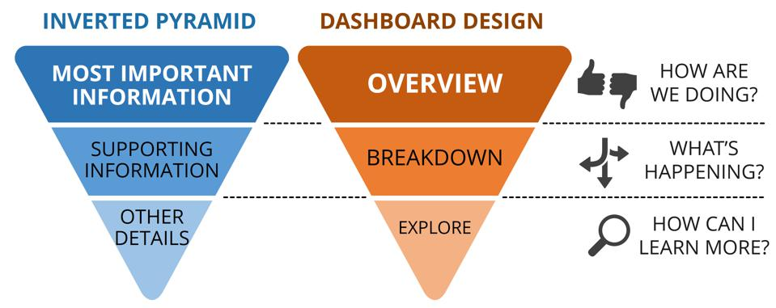
What’s the most Important Data?
Notes:
Give relevant infö first and immediate access
5-second design rule
Designers refer to this layout as the “inverted pyramid”. It helps designers consider the placement of each piece of data.
The top dashboard design principles also suggest giving users immediate access to the most important data. Designers call this the “five-second rule”. All relevant data should be reachable within five seconds after the dashboard loads.
As with the first suggestion, work with users to determine which data is most relevant to their business objectives. Display this data in a prominent spot on the dashboard.
After including the most important data, display the remaining information in a logical order. The typical layout starts with the most significant data at the top of the screen. The middle section is reserved for trends while granular details are placed at the bottom of the dashboard.
Designers refer to this layout as the “inverted pyramid”. It helps designers consider the placement of each piece of data.
Users can quickly see important insights at the top of the page. They can then scroll down to analyze the trends, which provide context to the insights at the top. Users that want to drill deeper into the details can scroll down to the bottom of the page for supporting data

Slide 5
What are the right visualizations for the data?
Don’t get too carried away.
Notes:
One of the most overlooked dashboard design principles is the need to select the right visualization tools. Designers often get carried away, selecting various charts, maps, tables, and graphs.
When selecting visualization methods, avoid cluttering the screen with a wide variety of charts and tables. Stick to a minimal selection of visualization types to maintain a consistent look throughout the dashboard.
Line charts are often used for showcasing data patterns. They are clear and easy for the average user to analyze quickly. Bar charts help compare data in the same category.
Pie charts are one of the least effective choices. Users often struggle to decipher pie charts due to the difficulty of analyzing the scale of each slice in the chart.
Tables are beneficial for displaying large amounts of data. However, if the table contains too much data, users may find it difficult to scan.
Some of the best dashboards do not include any visualization tools for the most relevant KPIs. The top KPIs are displayed in plain text at the top of the screen, helping them stand out compared to the rest of the data.

Slide 6
Is it easy and simple to understand?
K.I.S.S. – Keep It Simple Stupid
Notes:
Creating a simple interface is one of the most important dashboard design principles. Make it as easy as possible for users to analyze the information on the screen.
Group data into categories and separate each category with a box or line, helping to separate the most essential data from the least. Each section requires clear labels in readable fonts.
A simple design also includes a minimal amount of colors and fonts. Use a minimalist design scheme with just two or three colors for the various visualization tools and one font for each set of text. For example, all headers should use the same font.

Slide 7
Is it easy and simple to understand?
K.I.S.S. – Keep It Simple Stupid
Notes:
Creating a simple interface is one of the most important dashboard design principles. Make it as easy as possible for users to analyze the information on the screen.
Group data into categories and separate each category with a box or line, helping to separate the most essential data from the least. Each section requires clear labels in readable fonts.
A simple design also includes a minimal amount of colors and fonts. Use a minimalist design scheme with just two or three colors for the various visualization tools and one font for each set of text. For example, all headers should use the same font.

Slide 8
Dashboards I like:
https://samples.dundas.com/Dashboard/42abb938-b2a4-44c7-a68c-a42662249a7e?e=false&vo=viewonly
https://atlas.cid.harvard.edu/explore?country=undefined&product=undefined&year=2018&productClass=HS&target=Product&partner=undefined&startYear=1995

